Slide 1
Supervisor Prof. Dr. Taysir Hassan Abdel Hamid 2022
Bioportal & Ontology
Gspan Algorithm
Faculty of Computers and Information
Assiut University
Seminars in Bioinformatics...BNF412

Slide 2
Bioportal & Ontology
What is ontology:
ontology in philosophy:
- A branch of philosophy that deals with the nature and the organization of reality
- is the philosophical study of being, as well as related concepts such
as existence, becoming, and reality.
- it aims to find out what entities and types of entities exist
Astrocytoma
Astrocytomas are tumors that develop from certain star-shaped brain cells called astrocytes.
Astrocytes and similar cells form tissue that surrounds and protects other nerve cells found within the brain and spinal cord
Some astrocytomas grow very slowly and others can be aggressive cancers that grow quickly.
Anaplastic astrocytoma
is a rare malignant brain tumor.

Slide 3
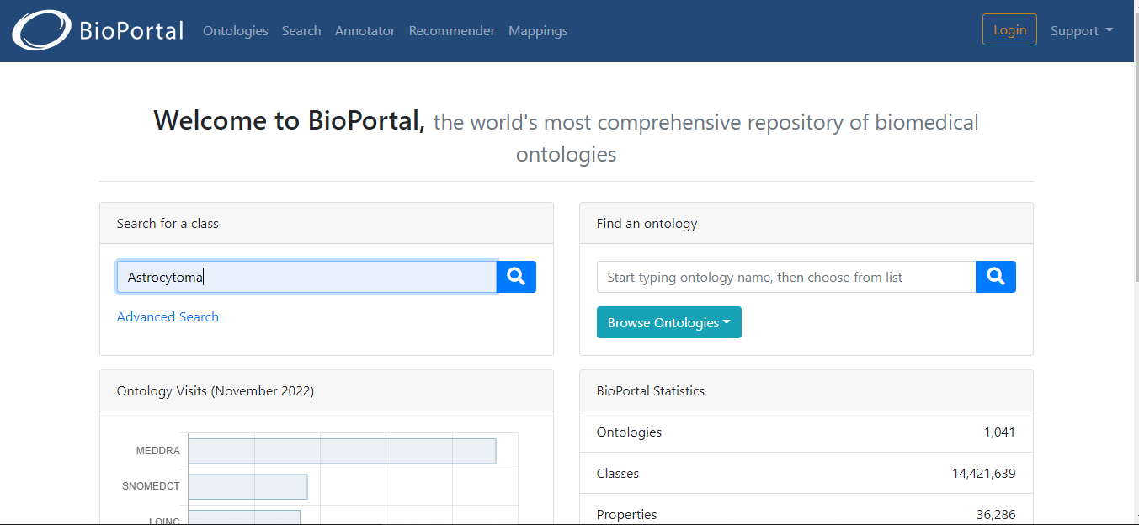
Bioportal
Bioportal & Ontology
We open bioportal site and write disease in class search

Slide 4
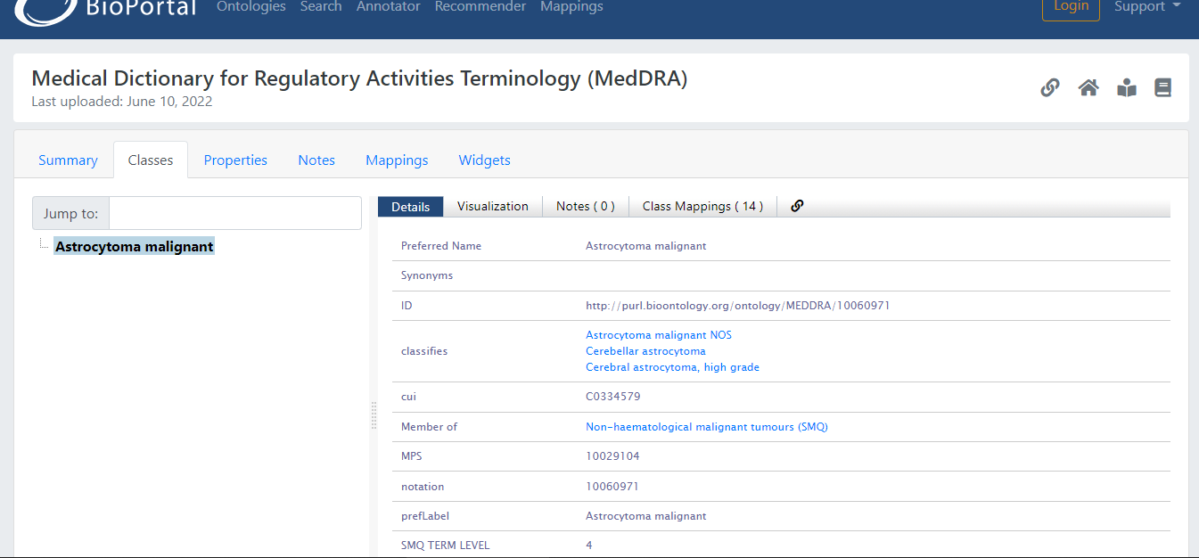
Bioportal & Ontology
As a result of the research, a lot of ontology associated with this disease

Slide 5
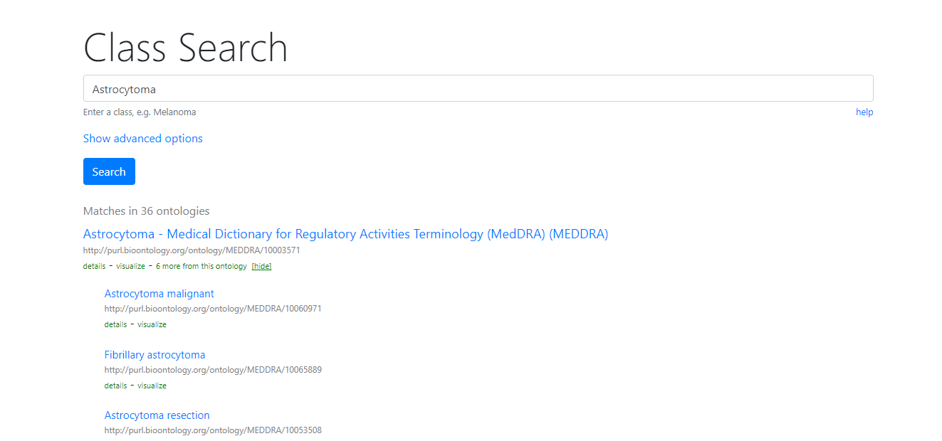
Bioportal & Ontology
We click on 6 more for the ontology in the first link

Slide 6
Bioportal & Ontology
we choose the first ontology from these ontologies "Astrocytoma malignant"

Slide 7
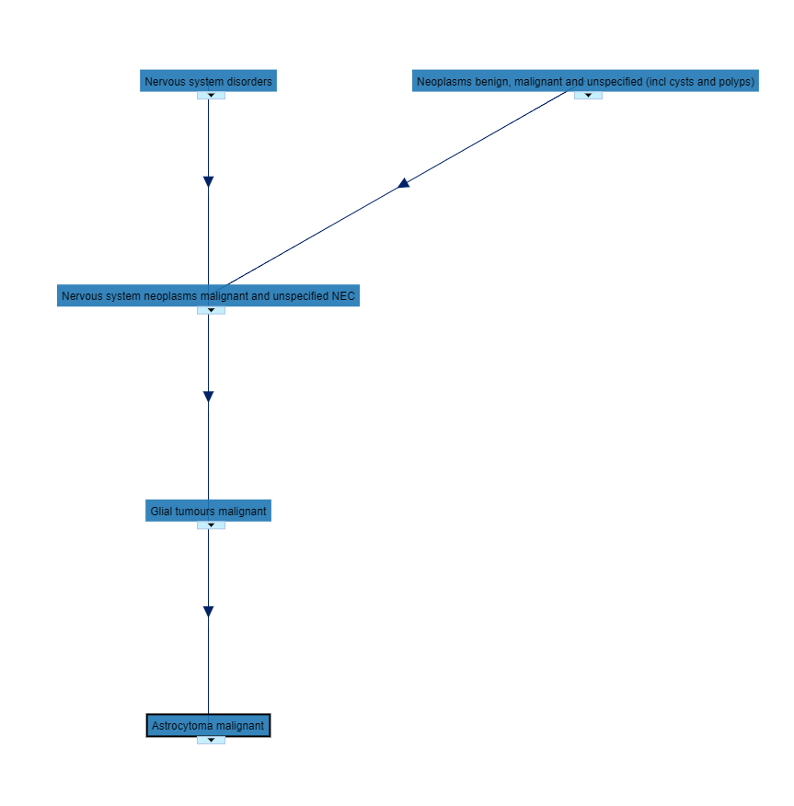
Bioportal & Ontology
click on visualization tab

Slide 8
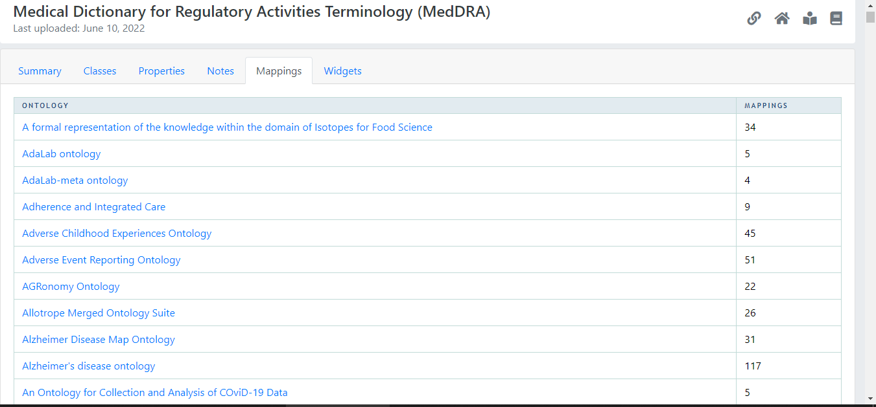
Bioportal & Ontology
Click on Mapping tab and choose the first ontology

Slide 9
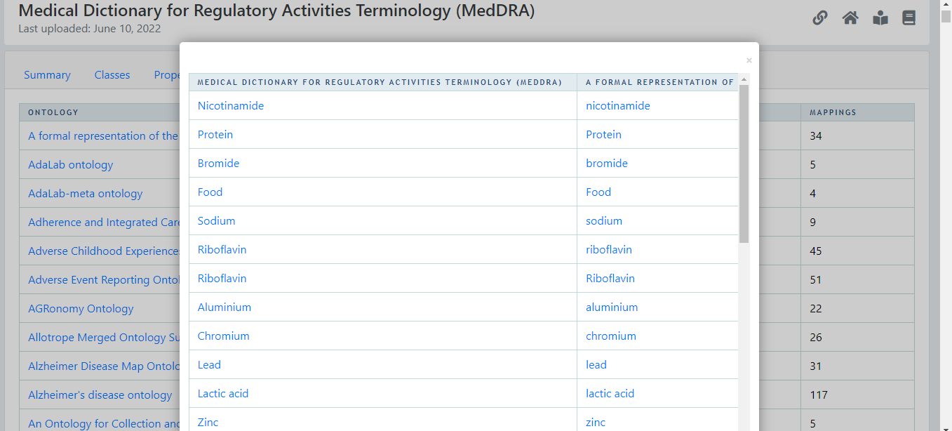
Bioportal & Ontology
Similarities between ontologies"

Slide 10
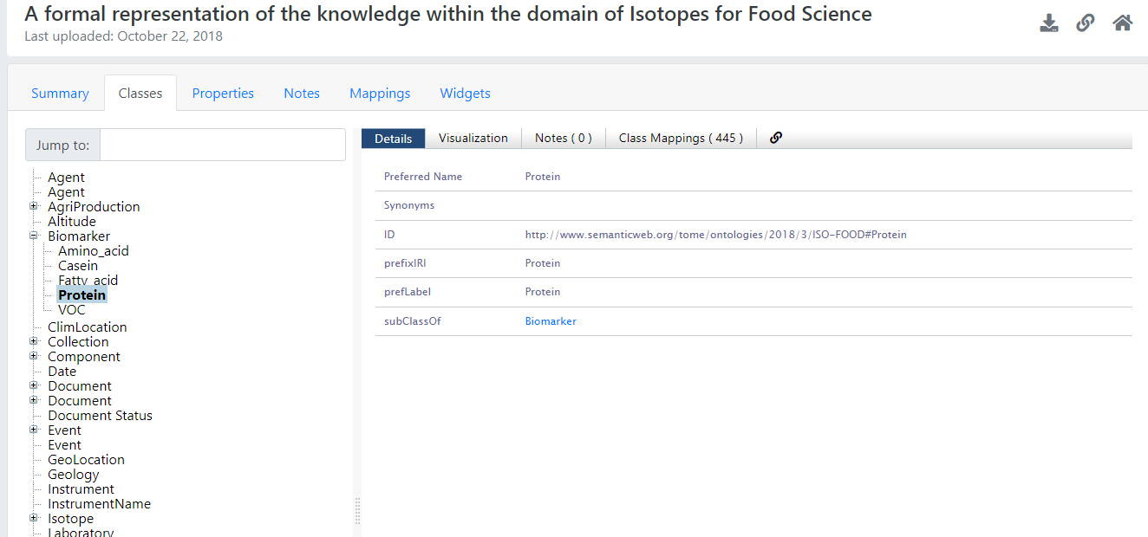
Bioportal & Ontology
We click on protein on "formal ontology"

Slide 11
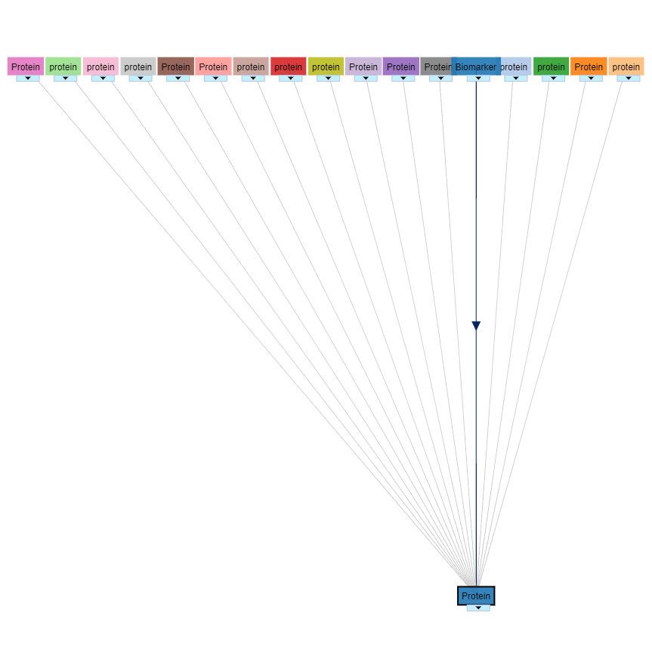
Bioportal & Ontology
click on visualization tab

Slide 12
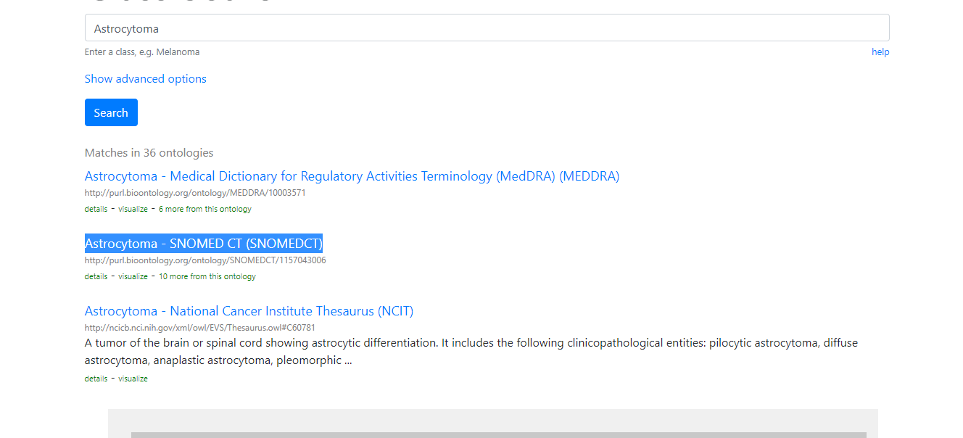
Bioportal & Ontology
we return to class search page and choose another ontology" Astrocytoma- SNOMED CT

Slide 13
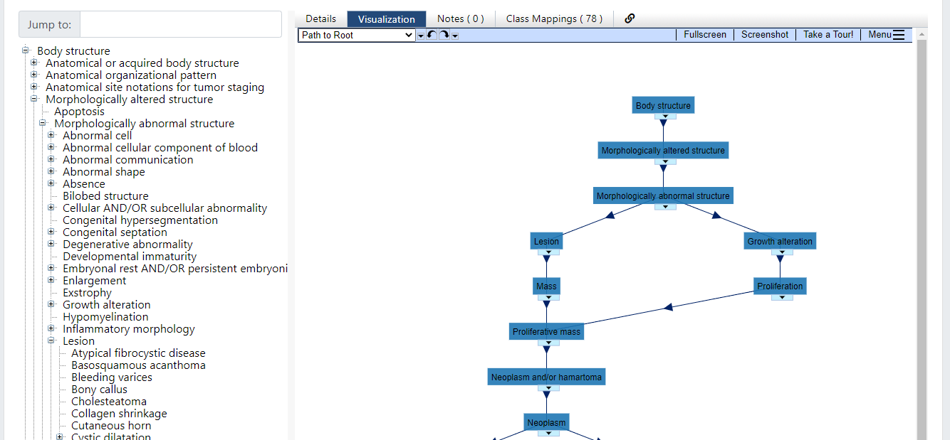
Bioportal & Ontology
click on visualization tab

Slide 14
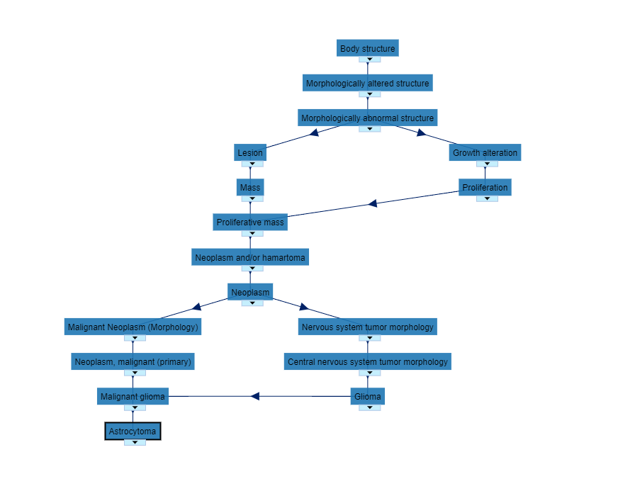
SNOMED CT Screenshot

Slide 15
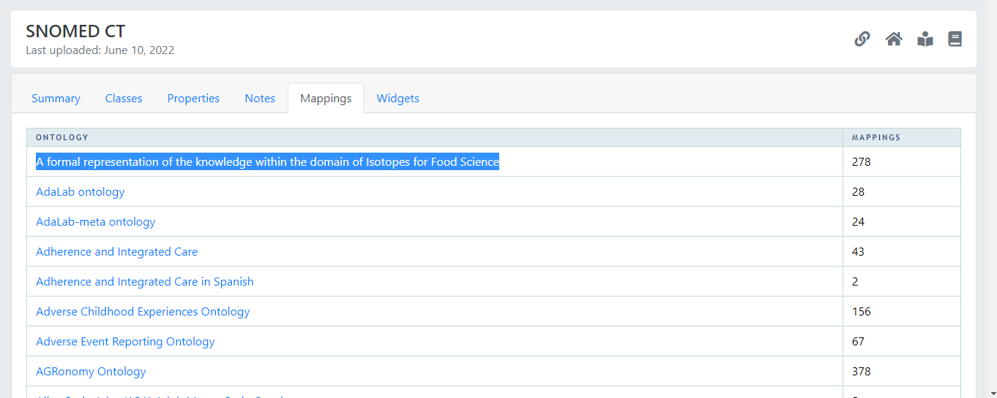
Bioportal & Ontology
click on Mapping tab and choose the first ontology

Slide 16
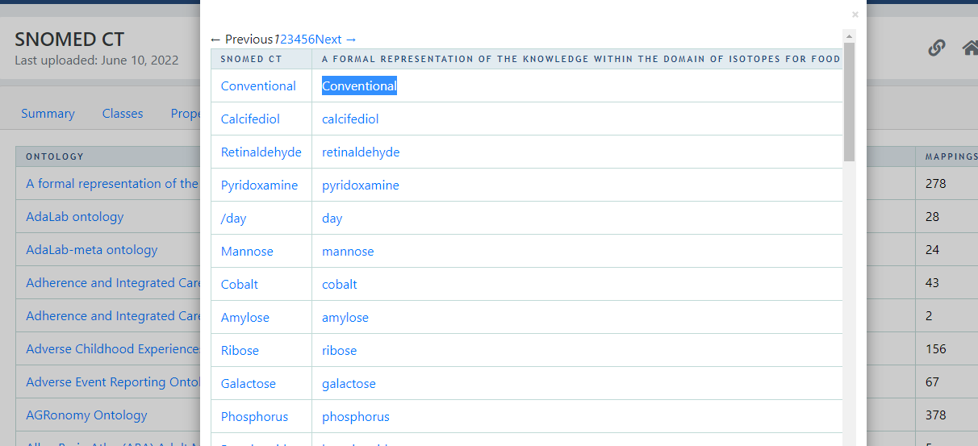
Bioportal & Ontology
Similarities between ontologies

Slide 17
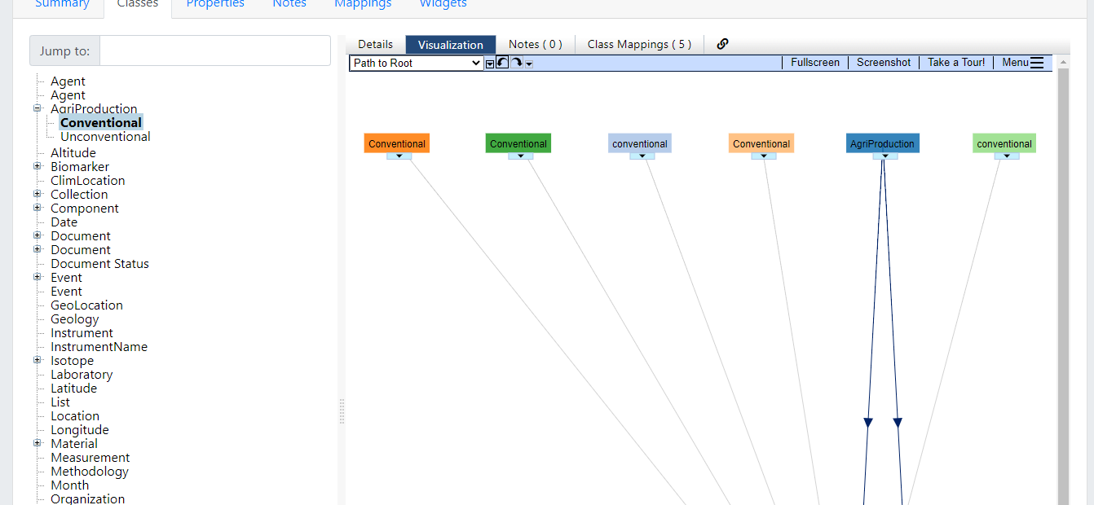
Bioportal & Ontology
click on visualization tab

Slide 18
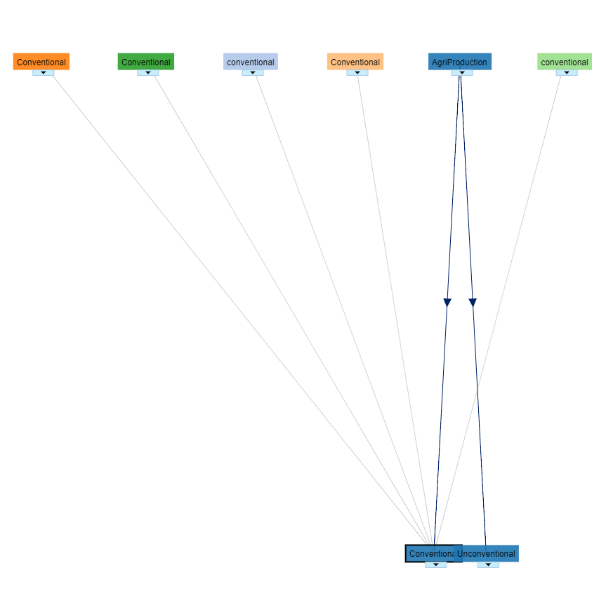
Bioportal & Ontology
The result of Virtualization

Slide 19
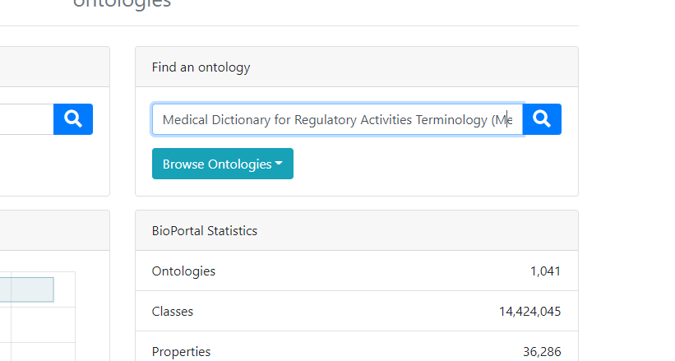
Second way: Search using Ontology
We write Ontology name(MedDRA)(MEDDRA) in ontology search

Slide 20
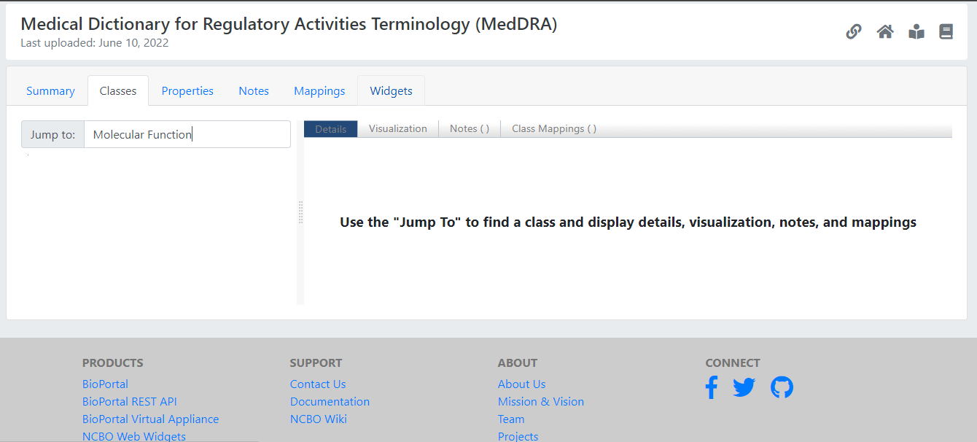
Second Way
Jump to : Molecular Function for this Ontology

Slide 21
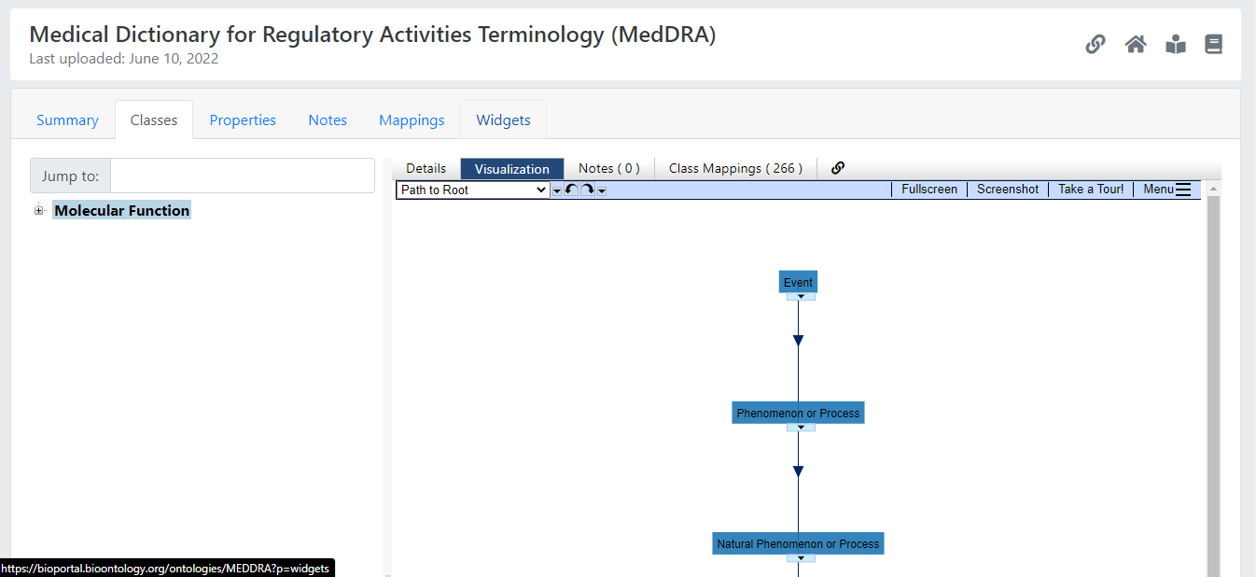
Second Way
We choose visualization tab for this Molecular Function

Slide 22
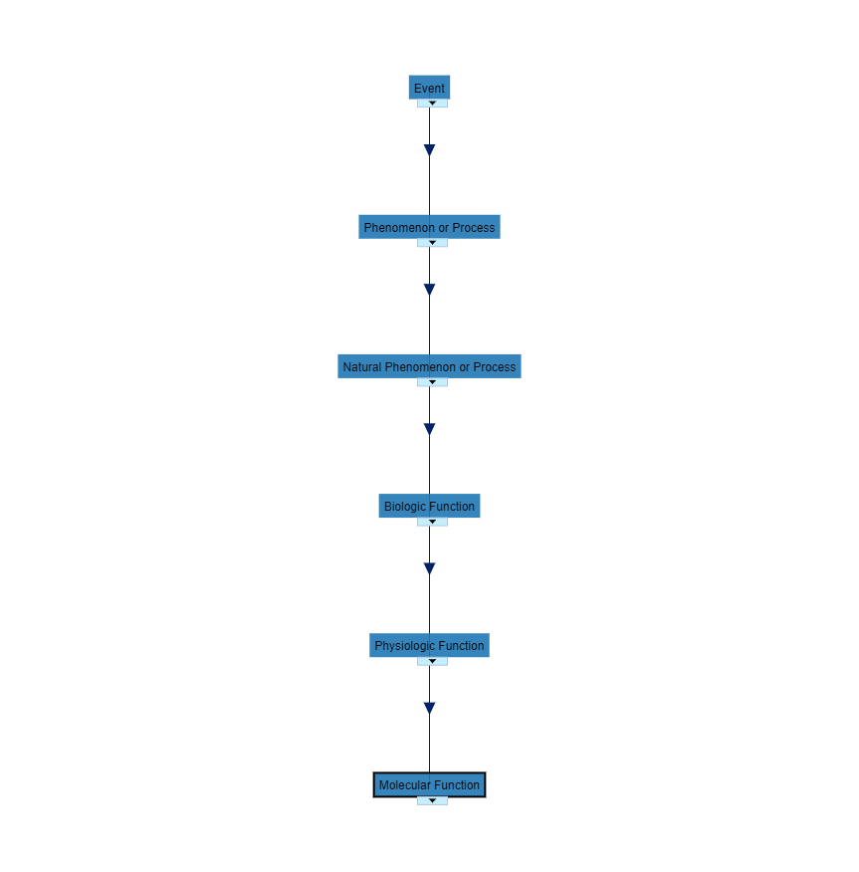
Second Way
Molecular Function Screenshot

Slide 23
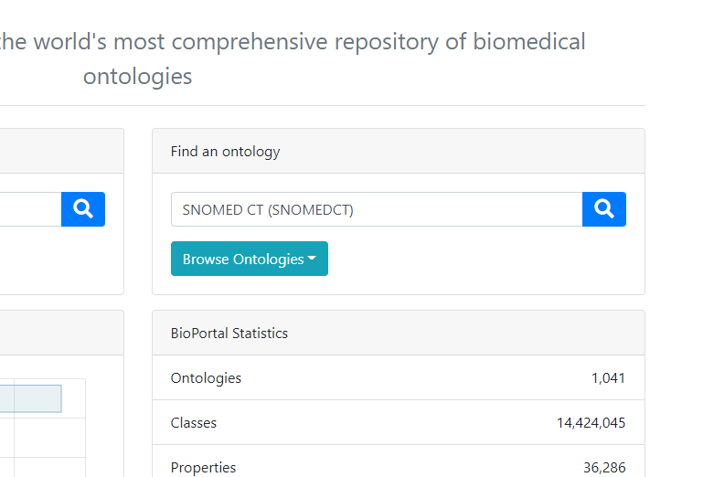
Second Way
We write Ontology name SNOMED CT in ontology search

Slide 24
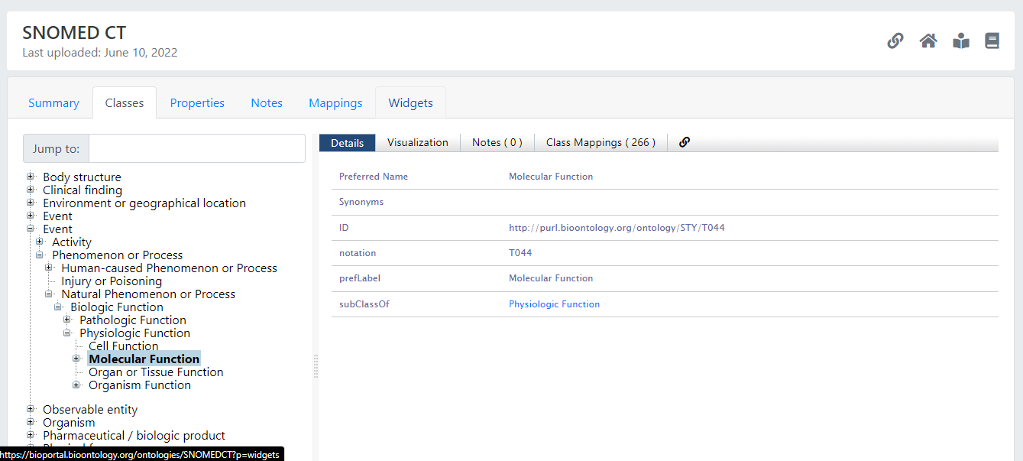
Second Way
Jump to : Molecular Function for this Ontology

Slide 25
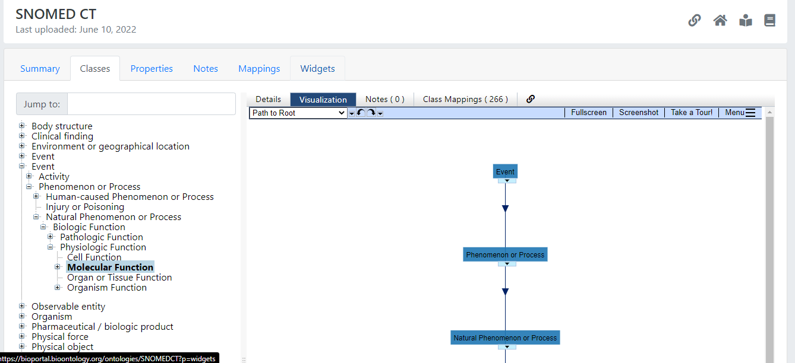
Second Way
We choose visualization tab for this Molecular Function

Slide 26
Second Way
Molecular Function Screenshot

Slide 27
Gspan Graph-based Substructure Pattern Mining
gSpan Algorithm
gSpan is a popular algorithm for discovering frequent subgraphs in a graph database. It was proposed by Yan et al
The gSpan algorithm is designed to reduce the generation of duplicate graphs
Does not extend duplicate graphs
Uses Depth First Order

Slide 28
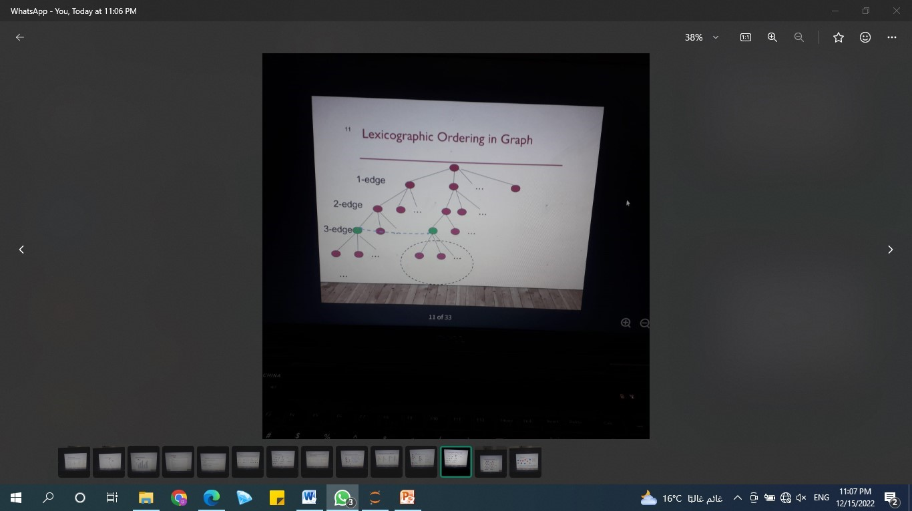
Gspan Graph-based Substructure Pattern Mining
gSpan uses a DFS (Depth First Search) lexicographic order to define a minimum code to uniquely represent each graph. This is achieved by building a DFS code tree to model the relations among all graphs. Each node of a DFS code tree represents a DFS code.
DFS (Depth-first search) is technique used for traversing tree or graph. Here backtracking is used for traversal. In this traversal first the deepest node is visited and then backtracks to it's parent node if no sibling of that node exist.

Slide 29
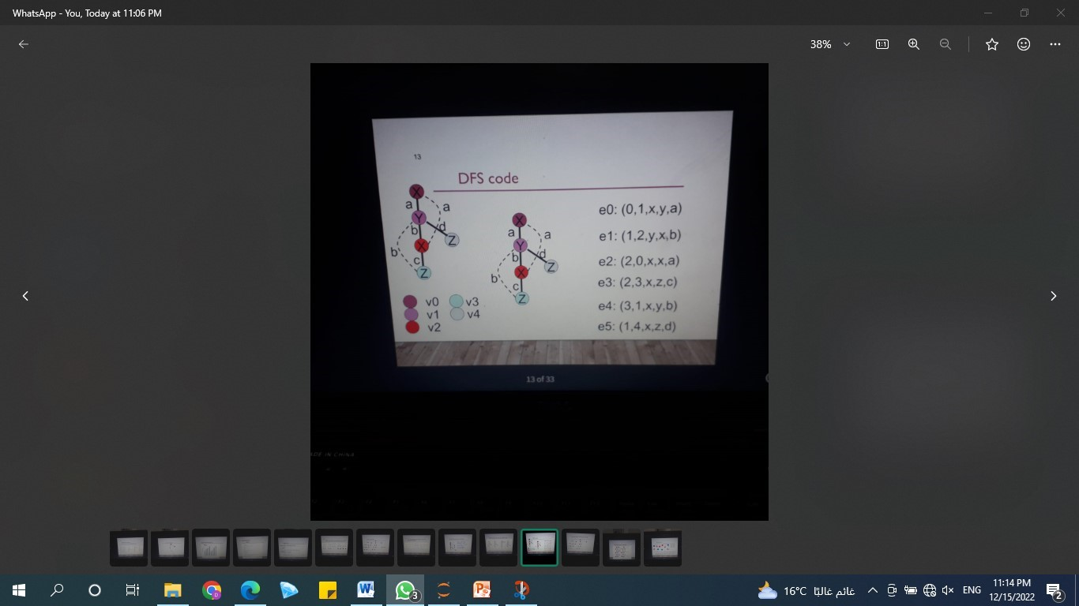
Gspan Graph-based Substructure Pattern Mining
Methodology
gSpan can be extended to handle mining directed graphs. In a directed graph, each edge of the graph has a defined direction. If we use a 5-tuple, (i, j,li ,l(i, j) ,lj), to represent an undirected edge, then for directed edges,

Slide 30
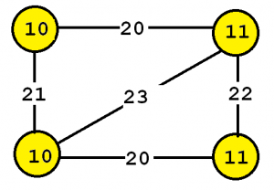
Gspan Graph-based Substructure Pattern Mining
The input is a set of labeled (a set of vertices and edges that have some labels) connected graphs and a threshold named minsup(a value between 0 and 100%)

Slide 31
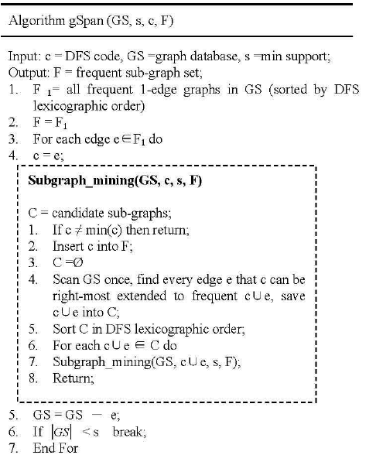
Gspan Graph-based Substructure Pattern Mining
Algorithm

Slide 32
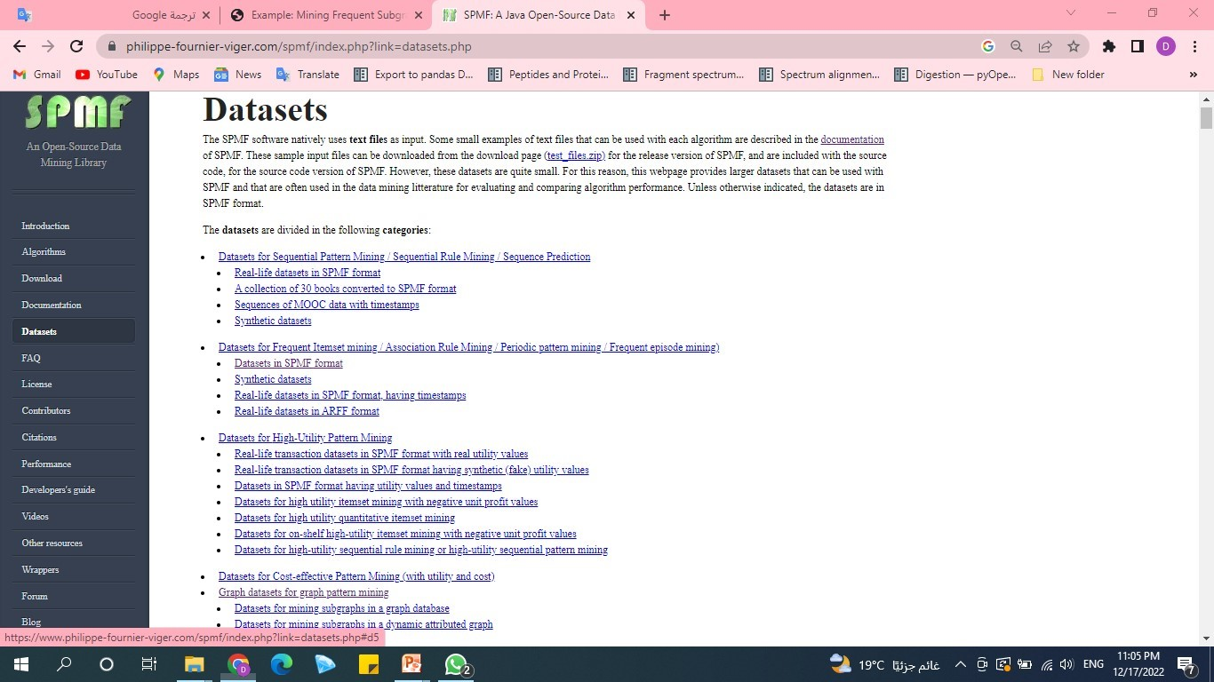
Gspan Graph-based Substructure Pattern Mining
Data Set
We have downloaded the
data set from SPMF website

Slide 33
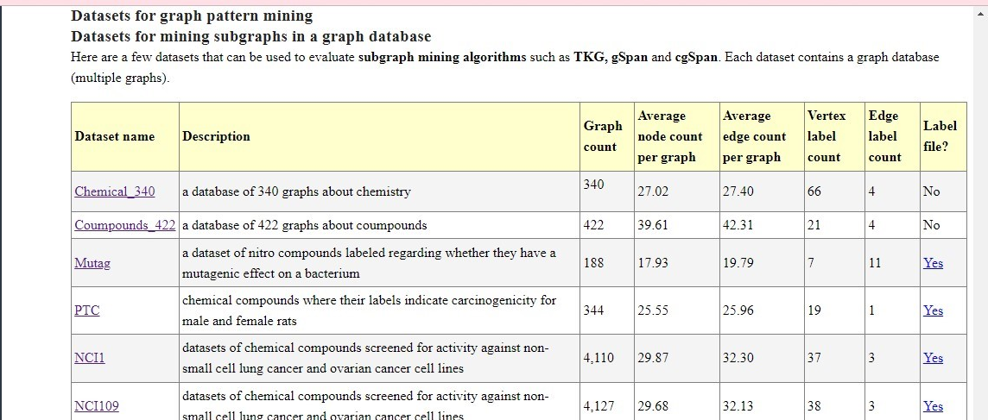
Gspan Graph-based Substructure Pattern Mining

Slide 34
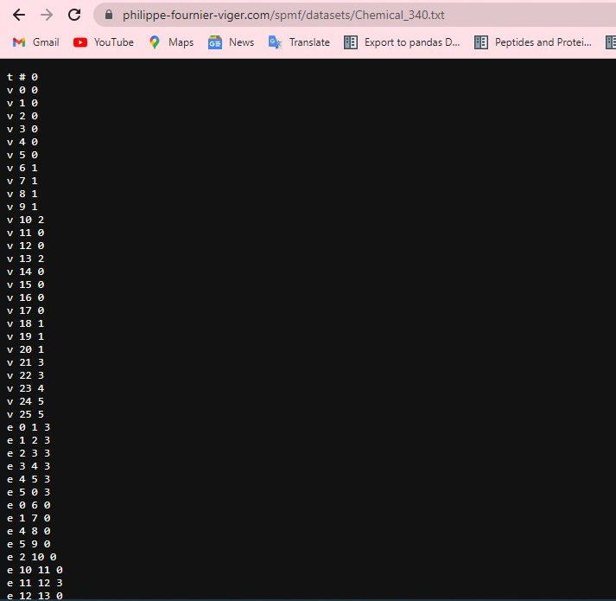
Gspan Graph-based Substructure Pattern Mining
Input file format
The input file format is defined as follows. It is a text file which contains one or more graphs. A graph is defined by a few lines of text that follow the following format:
t # N This is the first line of a graph. It indicates that this is the N-th graph in the file
v M L This line defines the M-th vertex of the current graph, which has a label L
e P Q L This line defines an edge, which connects the P-th vertex with the Q-th vertex. This edge has the label L

Slide 35
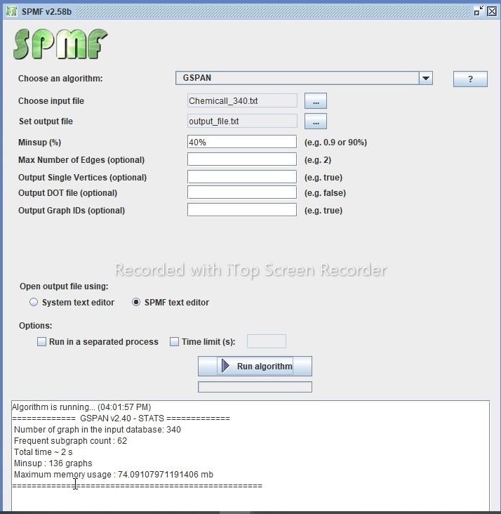
Gspan Graph-based Substructure Pattern Mining
we have used SPMF sofware for
Implement gspan algorithm on our dataset
-first,we have choosen our algorithm(GSPAN) ,
-Then, we have entered the dataset we will use (Chemical_340.txt),and output file (output_file.txt)
- finally,setting the minimum support (40%)and Run algorithm.

Slide 36
Gspan Graph-based Substructure Pattern Mining
Output file format
The output file format is defined as follows. It is a text file, listing all the frequent subgraphs found in the input graph database. A frequent subgraph is defined by a few lines of text that follow the following format:
t # N * Z This is the first line of a subgraph. It indicates that this is the N-th subgraph in the file and that its support is Z.
v M L This line defines the M-th vertex of the current subgraph, which has a label L
e P Q L This line defines an edge, which connects the P-th vertex with the Q-th vertex. This edge has the label L
x X1 X2 ... This lines lists the identifiers of all the graphs X1, X2 ... that contains the current subgraph

Slide 37
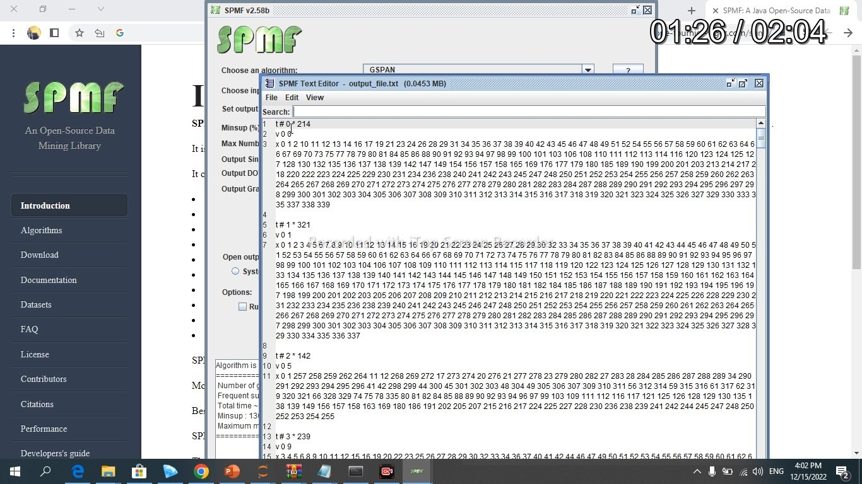
Gspan Graph-based Substructure Pattern Mining
The output file that contain the frequent patterns

Slide 38
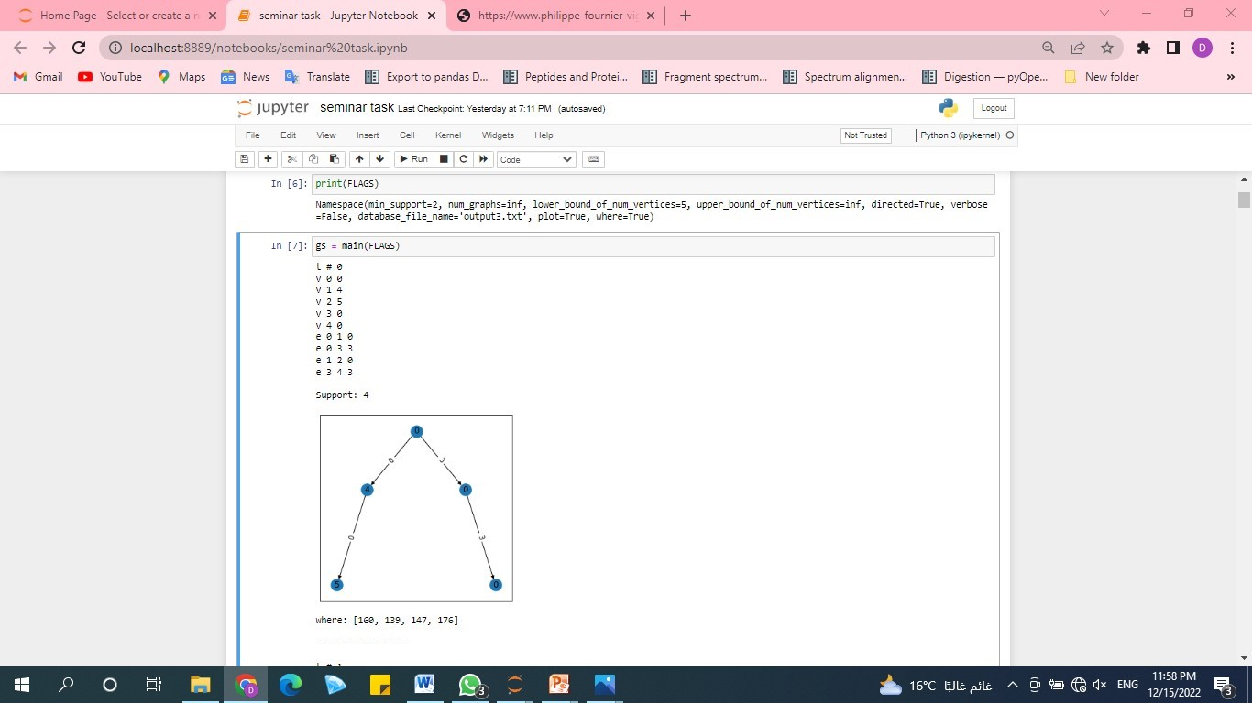
Gspan Graph-based Substructure Pattern Mining
Results
The output is the set of all subgraphs that appear in at least minsup percent of the graphs of the input graph database, and their support values.
Graph of the frequent items that is no less than min sup.(40%)

Slide 39
Presented By: Our Team
-Doaa Mohammed Sayed
-Reem Atef Abd-Eltawab
-Rasha Hamdy Abd-Elsattar
-Esraa Mohammed Abd-Elghny

Slide 40
REFERNCES
Dataset
We use Chemical_340.txt graph dataset.
https://www.philippe-fournier-viger.com/spmf/datasets/Compound_422.txt
SPMF software
https://www.philippe-fournier-viger.com/spmf/index.php?link=download.php
Code
http://localhost:8889/notebooks/seminar%20task.ipynb

Slide 41
Thank You

